Slide 1
Ancient Greek Historians

Slide 2
Writing History was a Greek invention:
ἱστορία = ‘enquiry’
What is History?
The study of past events
Real not made up

Slide 3
Herodotus: The Father of History

Slide 4
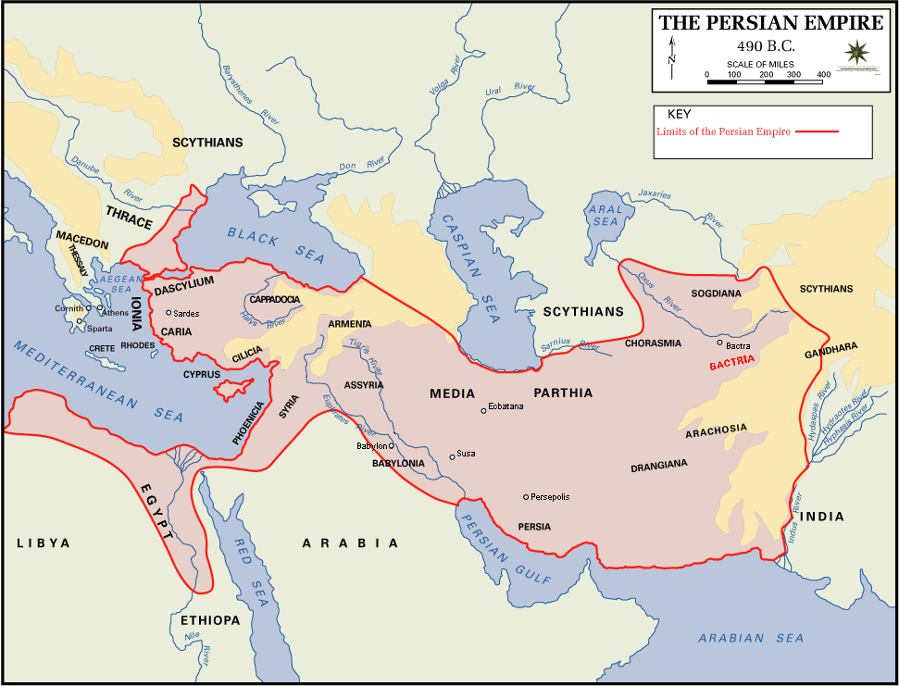
“Here are presented the results of the enquiry carried out by Herodotus of Halicarnassus. The purpose is to prevent the traces of human events from being erased by time, and to preserve the fame of the important and remarkable achievements produced by both Greeks and non-Greeks.”

Slide 5
Invasion of Greece and the battle of Marathon 490 BC

Slide 6
Herodotus: the father of lies?

Slide 7
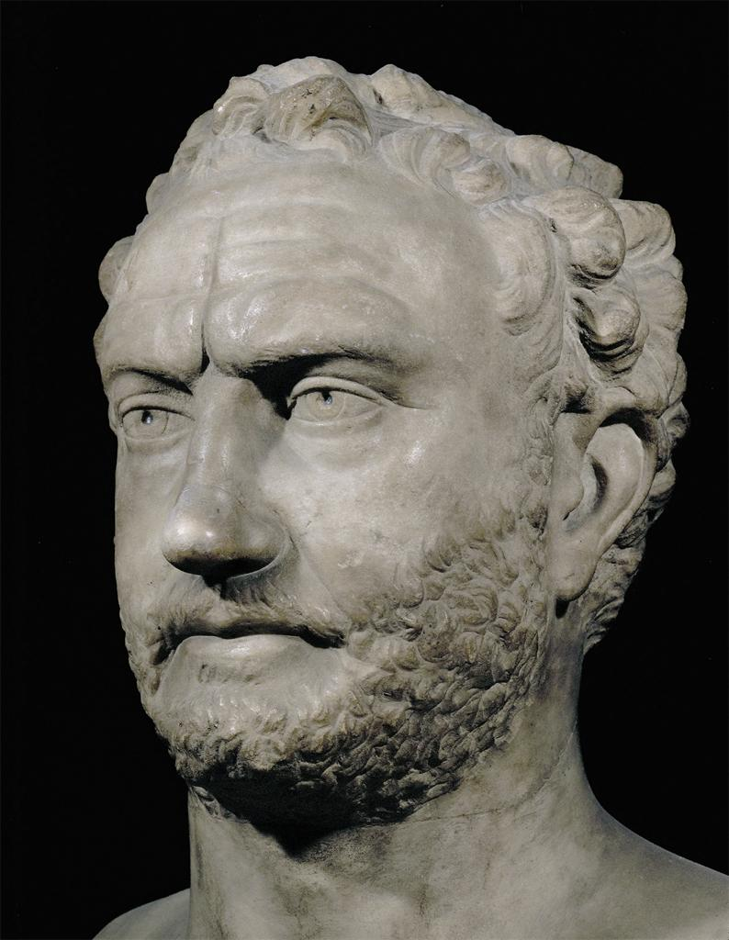
Thucydides

Slide 8
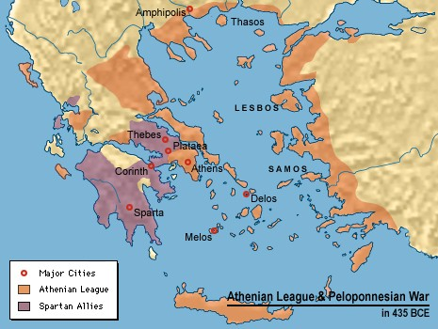
“Thucydides the Athenian wrote the history of the war fought between Athens and Sparta, beginning the account at the very outbreak of the war, in the belief that it was going to be a great war and more worth writing about than any other which had taken place in the past.”

Slide 9
The Spartans

Slide 10
The Athenians

